Slide 1
Is Collaboration in Science split along Gender Lines?
Network Analysis in R
Emma Vitz

Slide 2
When it comes to collaboration in science, who works with whom?

Slide 3
The Marsden Fund from 2008 - 2017
2284 researchers
1030 proposals funded across 11 panels.
Male | Female | Unknown Gender
1610 | 668 | 6

Slide 4
Panel | No. of Proposals Funded
Biomedical Sciences | 102
Cellular, Molecular & Physiological Biology | 95
Physics, Chemistry and Biochemistry | 77
Ecology, Evolution & Behaviour | 131
Earth Science and Astronomy | 107
Engineering & Interdisciplinary Sciences | 77
Mathematics & Information Sciences | 110
Physical Sciences & Engineering | 26
Economics & Human and Behavioural Sciences | 82
Social Sciences | 133
Humanities | 90

Slide 5
Male and female researchers seem to collaborate with about the same number of people.

Slide 6
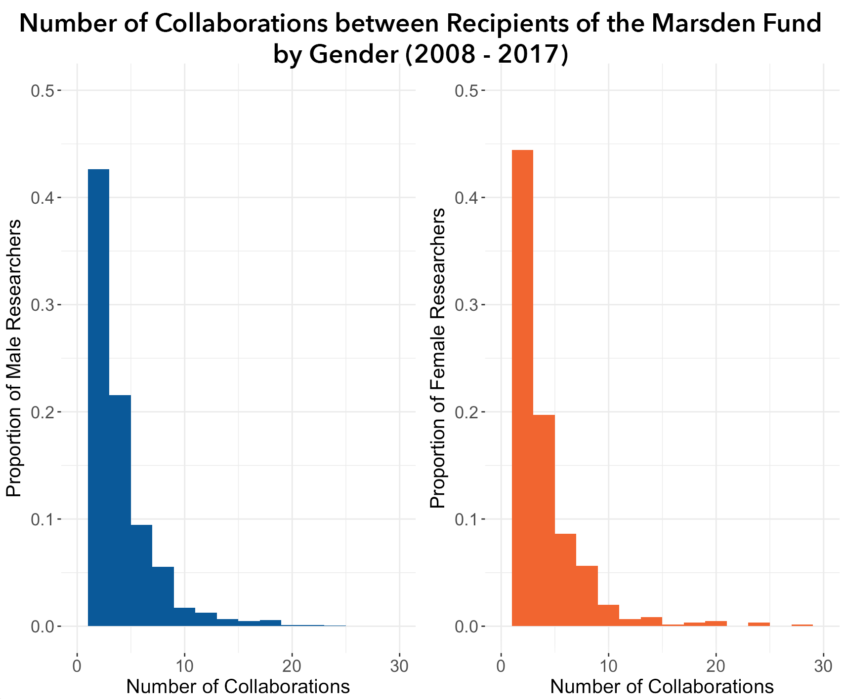

Slide 7
But women continue to be underrepresented in almost all fields, especially Mathematics and Information Sciences.

Slide 8
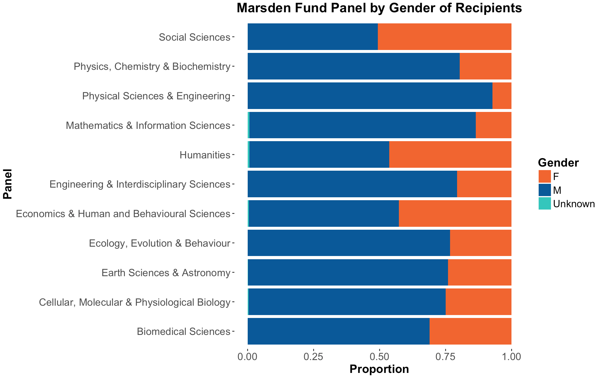

Slide 9
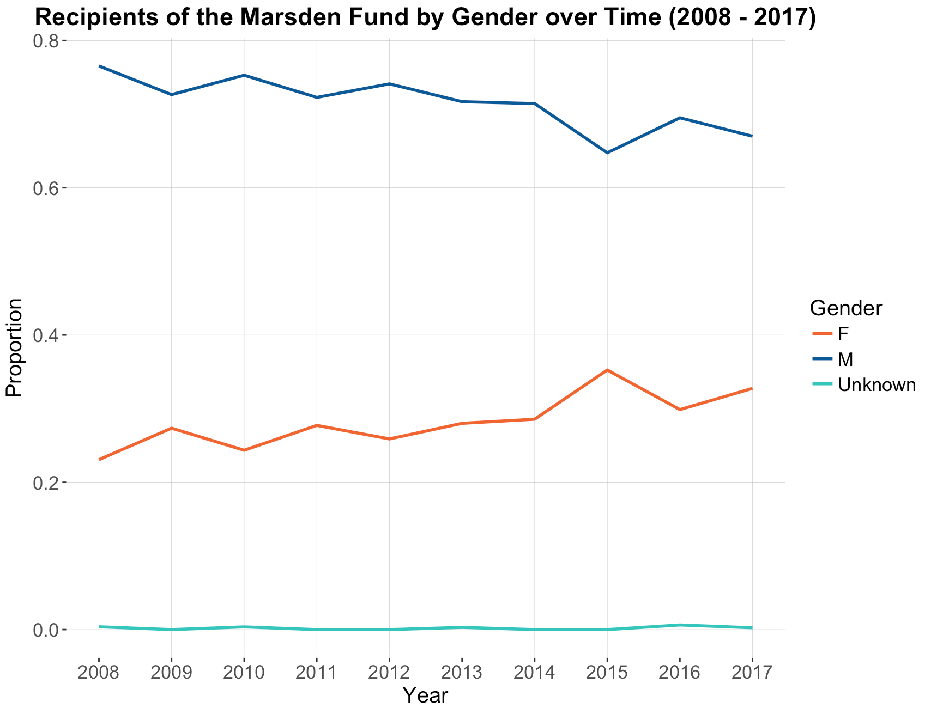

Slide 10
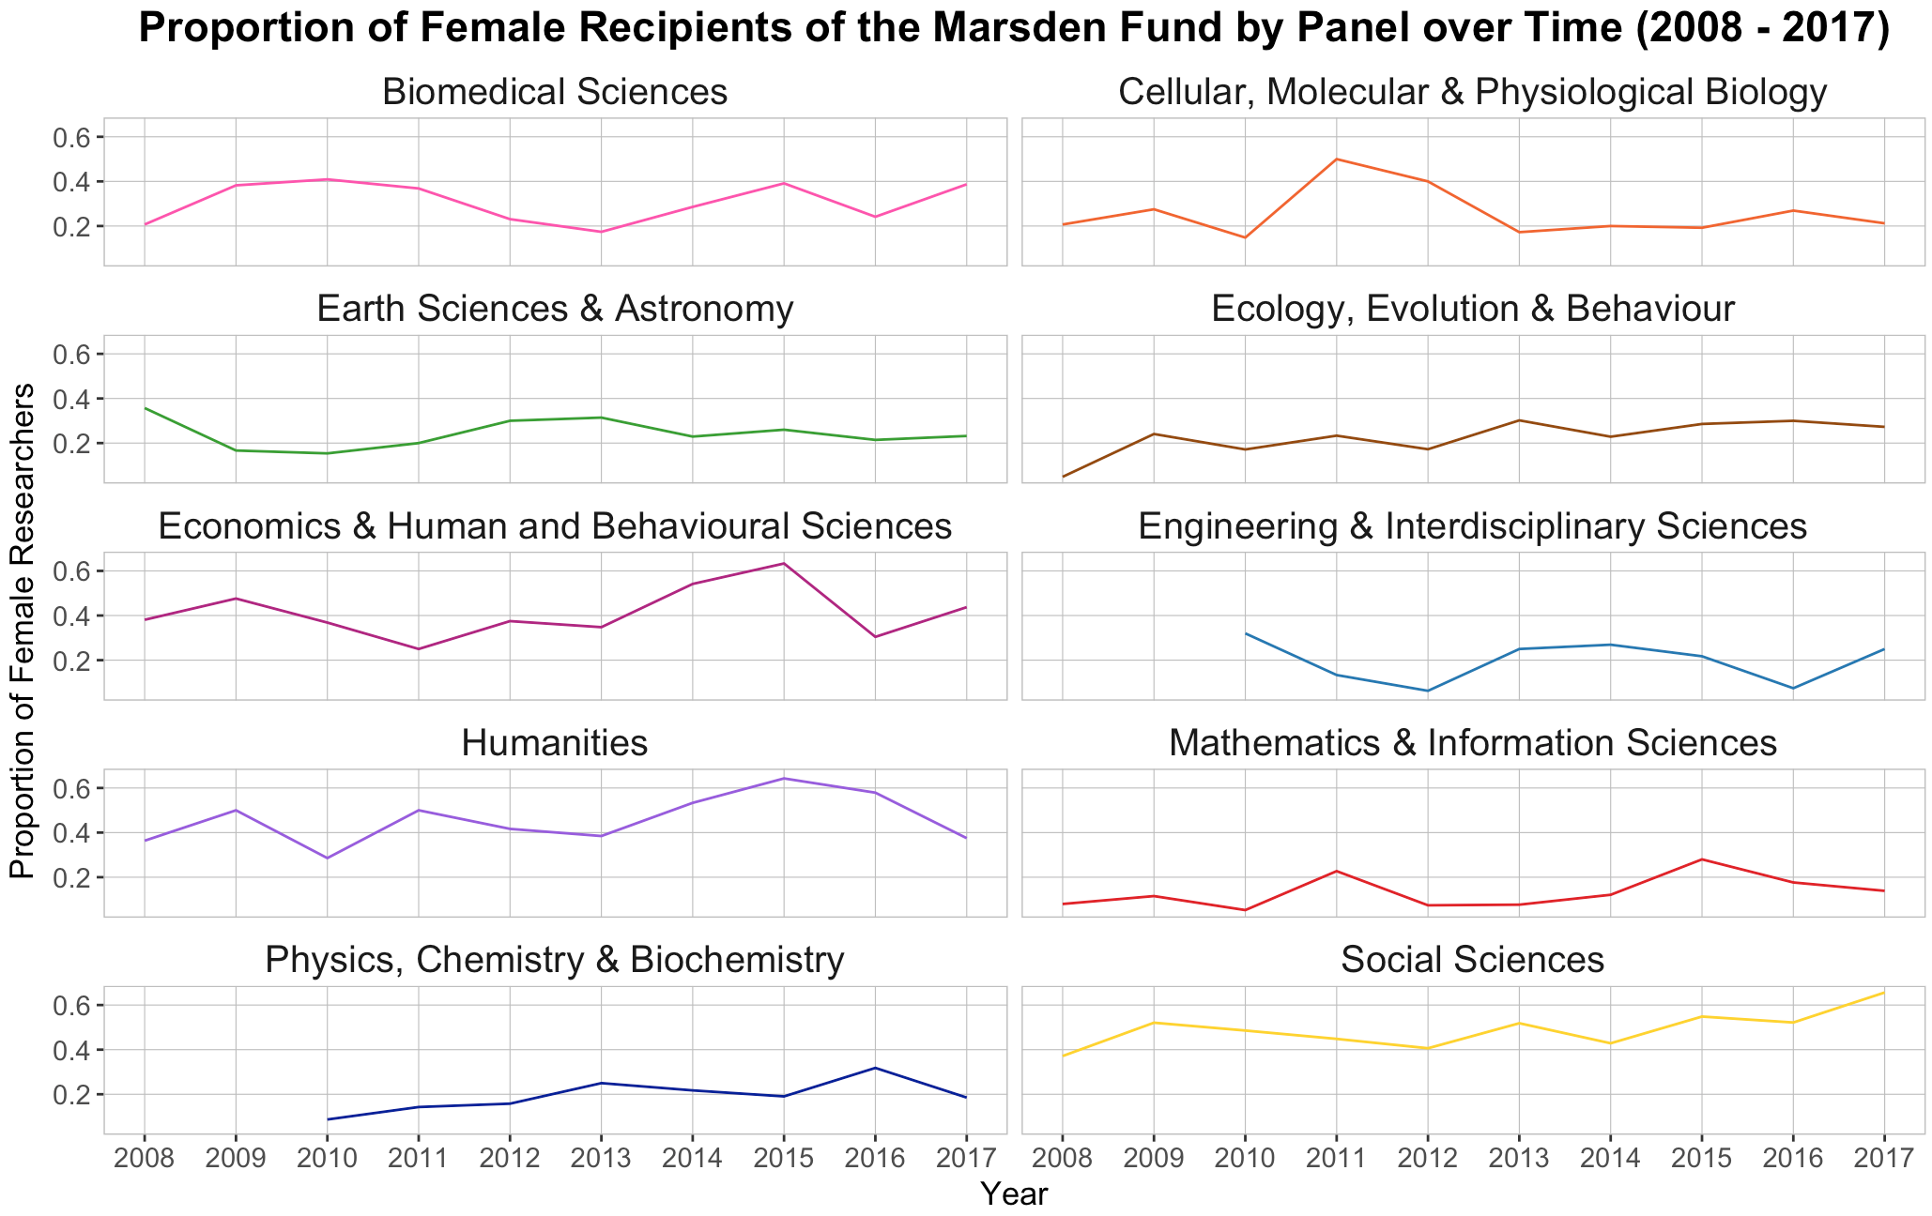

Slide 11
The network of science in New Zealand.

Slide 12
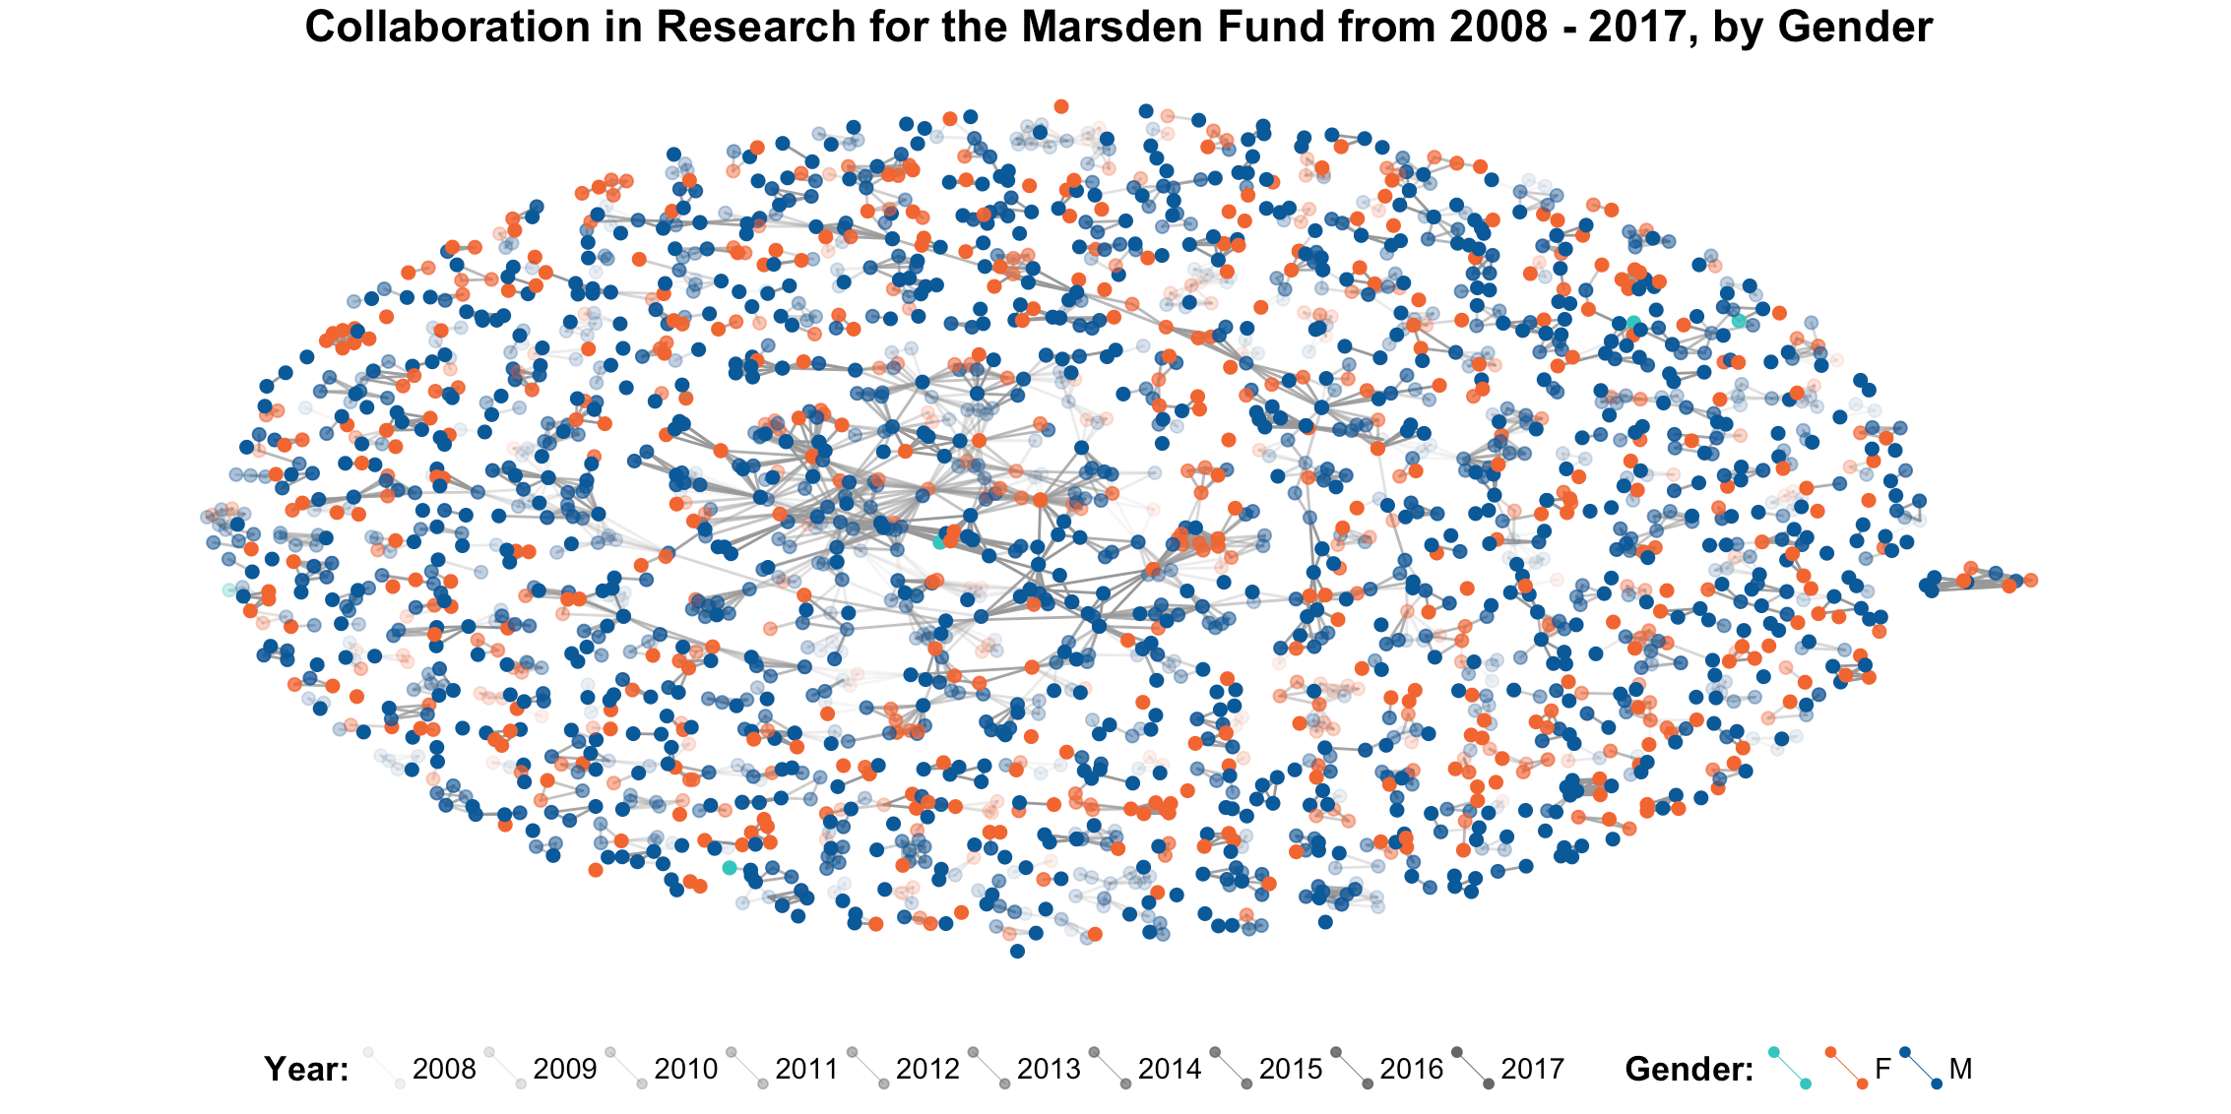

Slide 13
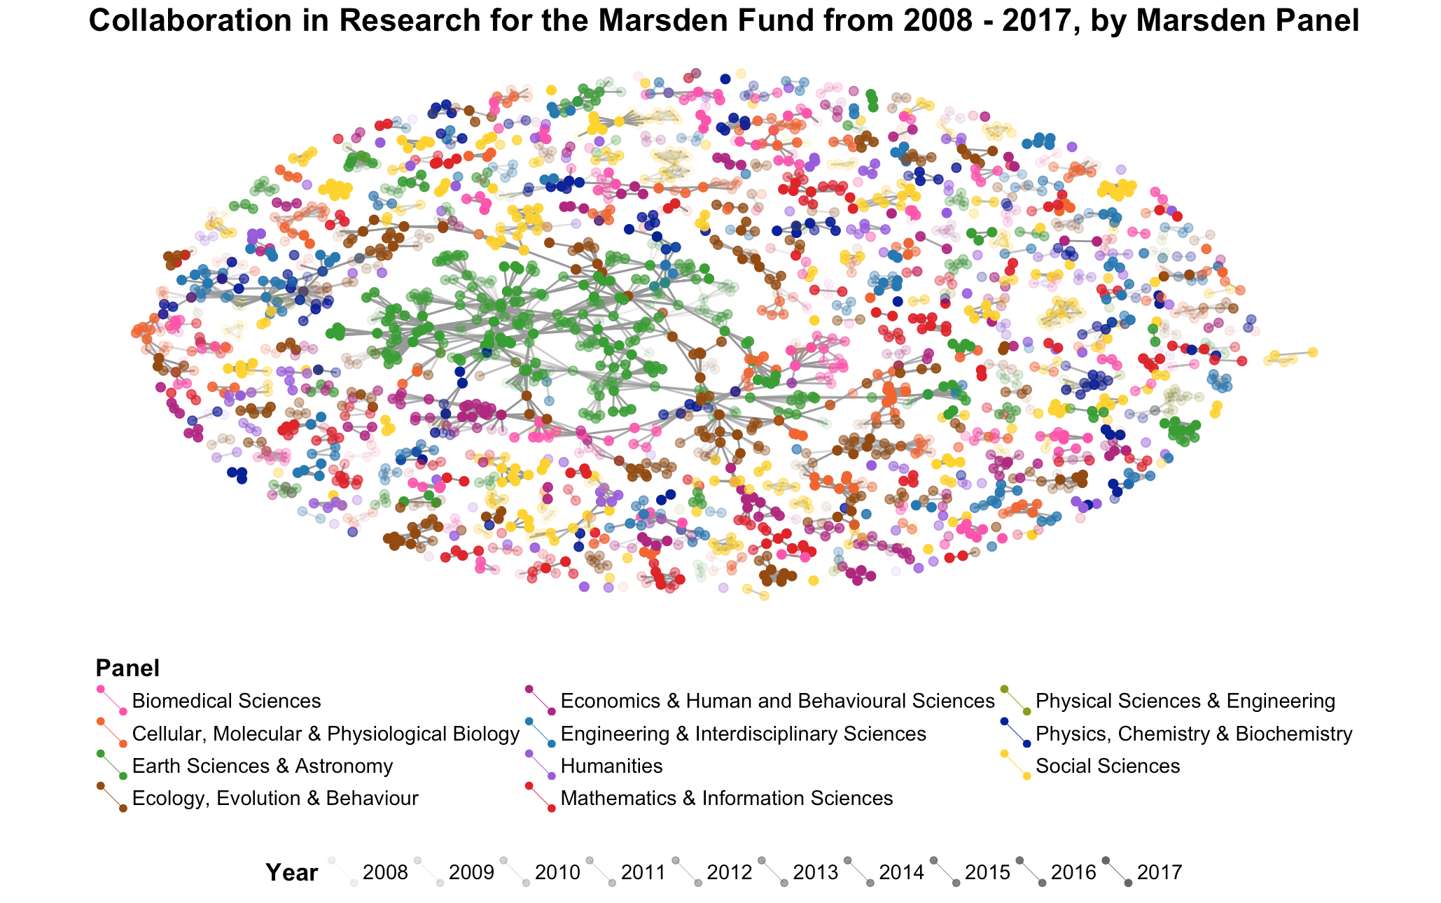

Slide 14
Homophily - the tendency of individuals to associate and bond with similar others.

Slide 15
Do we see gender homophily in scientific collaboration?
i.e. Are people more likely to collaborate with people of the same gender as them?

Slide 16
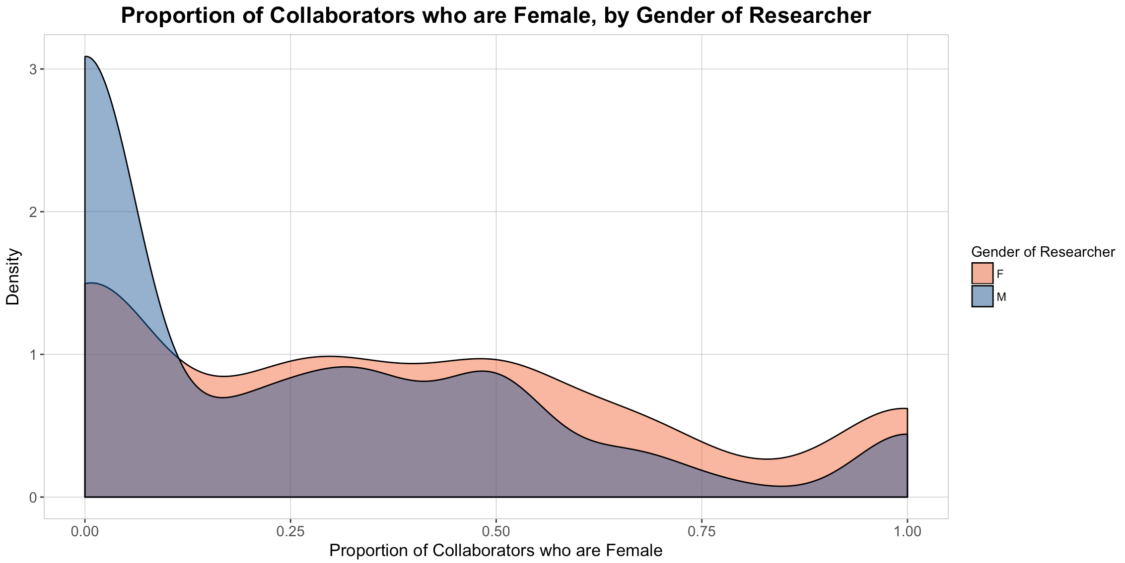

Slide 17
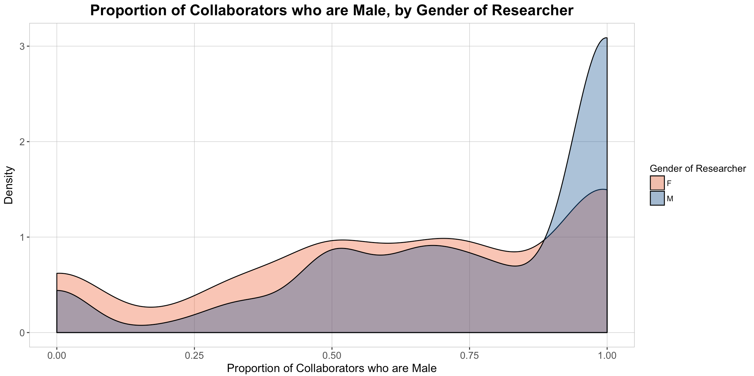

Slide 18
All researchers have a higher proportion of male collaborators - but this difference is greater for male researchers.

Slide 19
What about when we take the makeup of the field of research into account?

Slide 20
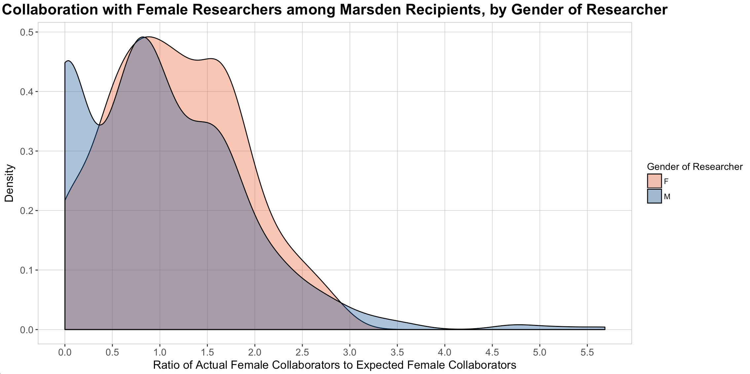
Fewer female collaborators than expected
More female collaborators than expected

Slide 21
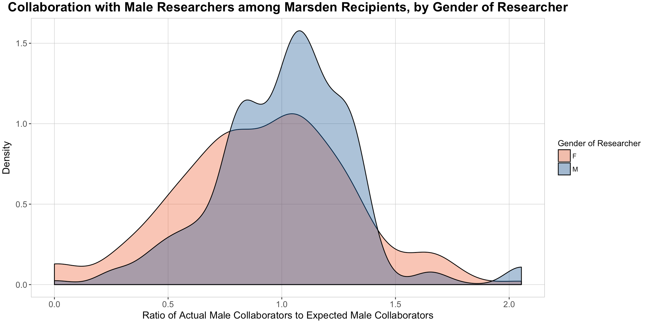
Fewer male collaborators than expected
More male collaborators than expected

Slide 22
 | Median ratio of actual vs. expected collaborations
 | With female researchers | With male researchers
By male researchers | 0.83 | 1.05
By female researchers | 1.13 | 0.96

Slide 23
There is some evidence of gender homophily in scientific collaboration.

Slide 24
Women are more likely to work with other female collaborators, while men are less likely to work with female collaborators than we would expect.
The same trend can be seen with male collaborators, but it is less pronounced.

Slide 25
There are many possible reasons for this:
Female researchers sticking together in a male dominated field?
Female researchers being stuck in ‘gender silos’?
Something else?

Slide 26
Limitations of the research
People who have been awarded a Marsden fund do not represent their field as a whole. We will have missed many other people and collaborations outside of the Marsden Fund.

Slide 27
The ratio of actual vs. expected collaborations with male and female researchers does not consider why there is a gender imbalance in most fields to begin with.
This data only includes successful Marsden applications. Their may be bias in what kinds of applications are successful.

Slide 28
Only people who have collaborated with 5 or more researchers from 2008 - 2017 were included in the analysis of homophily. This is not evenly distributed across fields. Some fields may show greater or less gender homophily.

Slide 29
Panel | No. of Researchers who have Collaborated with 5 or more People.
Biomedical Sciences | 28
Cellular, Molecular & Physiological Biology | 61
Physics, Chemistry and Biochemistry | 17
Ecology, Evolution & Behaviour | 102
Earth Science and Astronomy | 203
Engineering & Interdisciplinary Sciences | 42
Mathematics & Information Sciences | 29
Physical Sciences & Engineering | 17
Economics & Human and Behavioural Sciences | 39
Social Sciences | 94
Humanities | 3

Slide 30
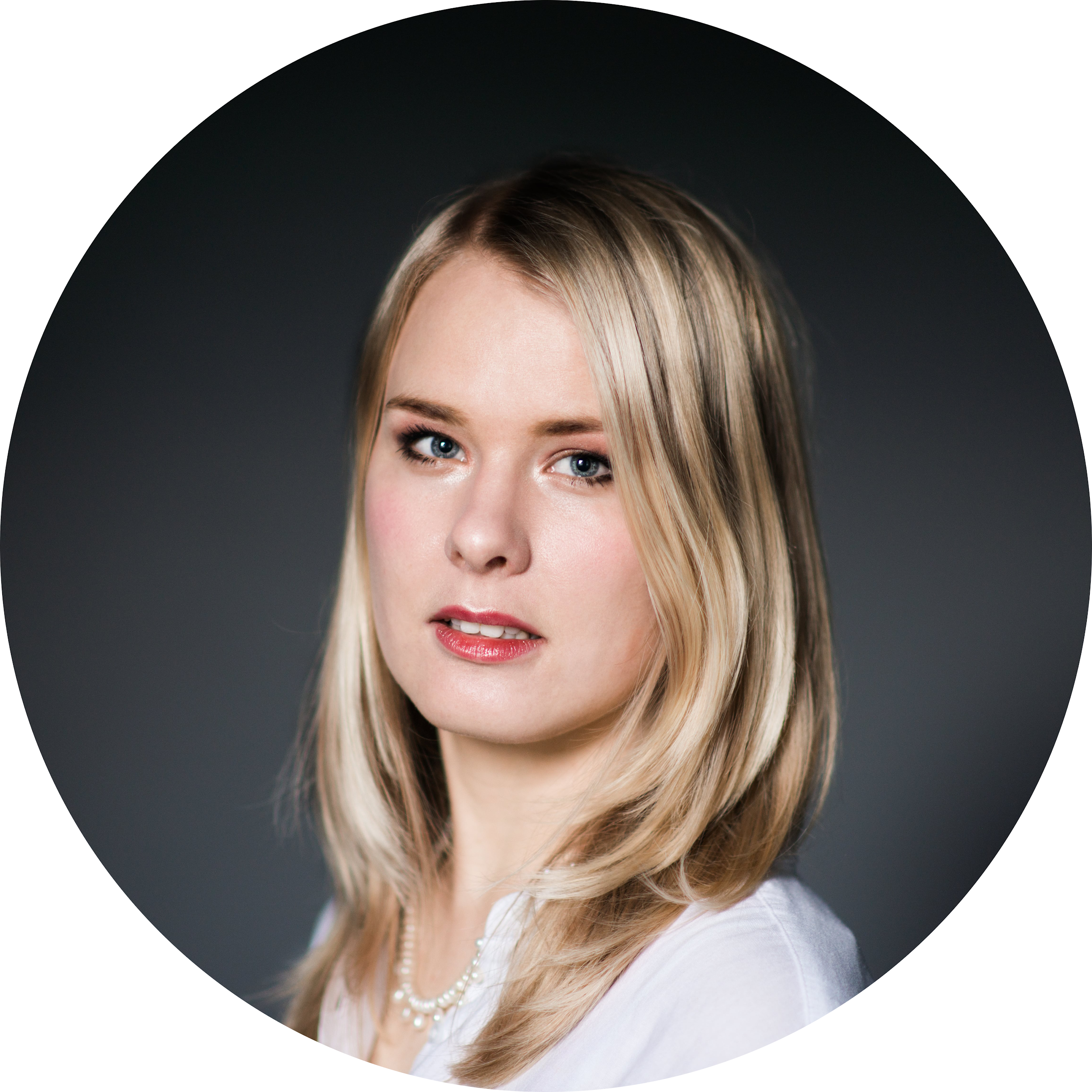
Stay in touch…
@EmmaVitz
linkedin.com/in/emma-vitz/
github.com/EmVitz

